Slide 1
HR Attrition Analysis
Erick Huang

Slide 2
Business Problem
Attrition Analysis to reduce attrition rate for the company

Slide 3
Dataset
Data: HR dataset of the company
The dataset came in 5 different CSV files
Employee Survey Data
General Data of the employee with job functions, education, and years with the company
Manager Survey Data
Employee In Time
Employee Out Time

Slide 4
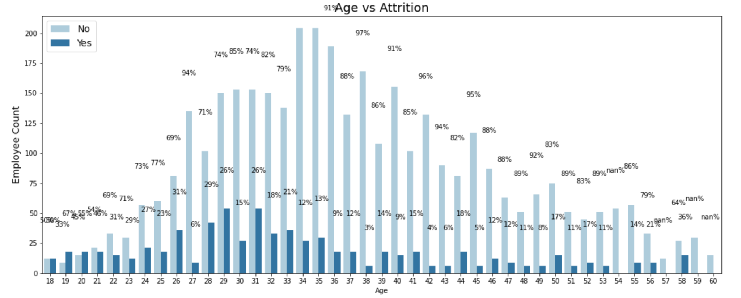
Age vs Attrition

Slide 5
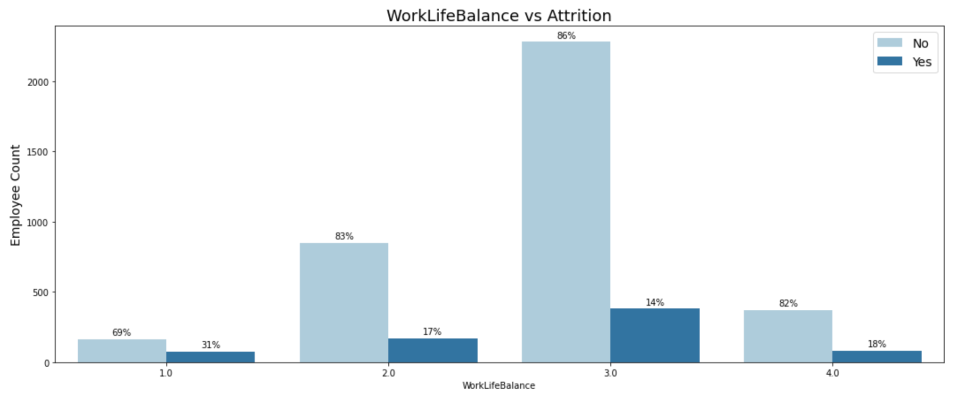
Work Life Balance vs Attrition

Slide 6
Machine Learning Models
Models:
Random Forest Classifier, Decision Tree Classifier, Bagging Classifier
Random Forest Classifier performed the Best:
Predicted highest accuracy at 99%

Slide 7
Recommendation & Retrospective
Random Forest Classifier:
Performed the best
Predicted the highest accuracy and highest efficiency
Retrospective
Accuracy is too high perhaps its overfitting
Further investigation and analysis will need be performed

